Slide 1
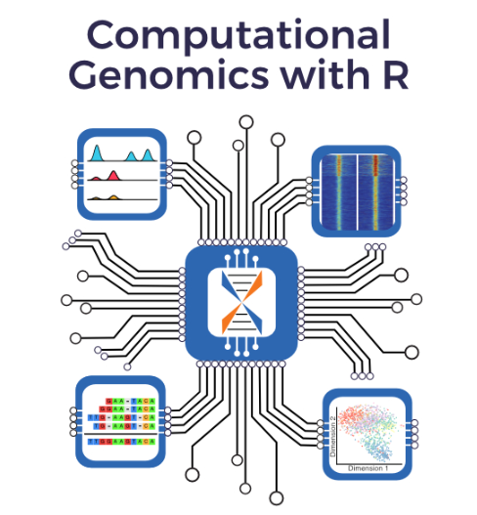
Computational Genomics Data Analysis with R Programming
Part4

Slide 2
General info Book
Fundamentals for data analysis for genomics
Interdisciplinary audience with backgrounds in physics, biology, medicine, math, computer science or other quantitative fields.
Starting point for computational genomics students and a guide for further data analysis in more specific topics in genomics
Cover a large variety of topics from programming to basic genome biology.

Slide 3
Book is for?
Biologists and medical scientists who generate the data and are keen on analyzing it themselves.
Students and researchers who are formally starting to do research on or using computational genomics
Beginner-level understanding in a quantitative field, for example, math, stats.
Experienced researchers looking for recipes or quick how-to’s to get started in specific data analysis tasks related to computational genomics.

Slide 4
Book Structure
1 Introduction to Genomics
2 Introduction to R for Genomic Data Analysis
3 Statistics for Genomics
4 Exploratory Data Analysis with Unsupervised Machine Learning
5 Predictive Modelling with Supervised Machine Learning
6 Operations on Genomic Intervals and Genome Arithmetic
7 Quality Check, Processing and Alignment of High-throughput Sequencing Reads
8 RNA-seq Analysis
9 ChIP-seq analysis
10 DNA methylation analysis using bisulfite sequencing data
11 Multi-omics Analysis

Slide 5
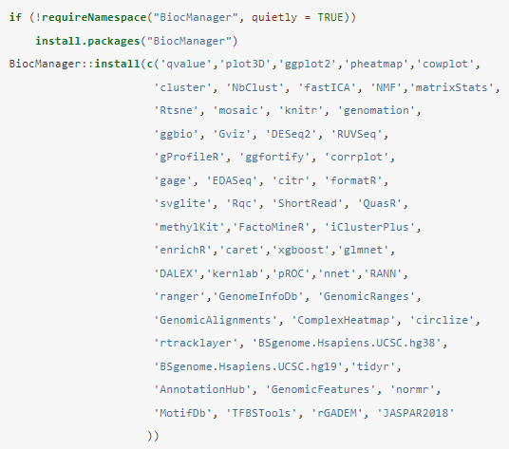
Software info & Packages
Packages
R Studio
R Cran
Anaconda (R studio Notebook)

Slide 6
Data
compGenomRData → Complete Genome Packages
github.com/compgenomr/compGenomRData
Altuna Akalin
bioinformatics scientist
head of Bioinformatics and Omics Data Science
Berlin Institute for Medical Systems Biology
Max Delbrück Center in Berlin
Berlin, Germany

Slide 7

Just now started

